Slide 1

Stock Market Analysis
PRESENtED BY:
Poojashree v VIVEK HADPAD
Sumit SWARUP KOTA SRI SOWMYA
GODE KRISHNA DURGA PRASAD

Slide 2
Introduction
Overview of Stock Market Analysis
Importance of stock market prediction.
Challenges in predicting stock prices due to market volatility.
Objective:
Use machine learning to predict stock prices and trends.

Slide 3
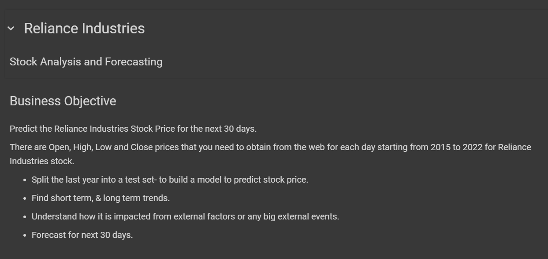
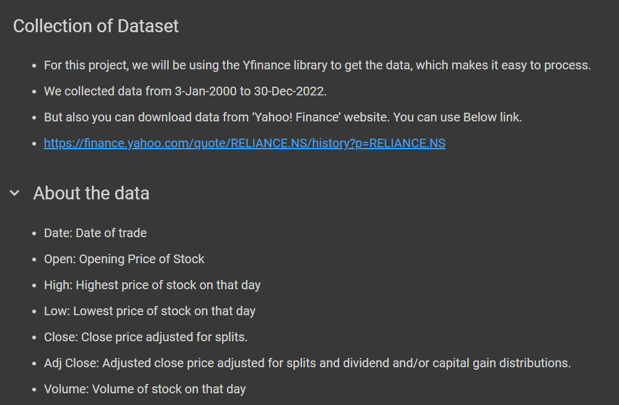

Slide 4
Data Collection
Source of Data:
Historical stock prices (e.g., RELIANCE STOCK).
Data Description:
Variables like Date, Open, High, Low, Close, Volume.

Slide 5
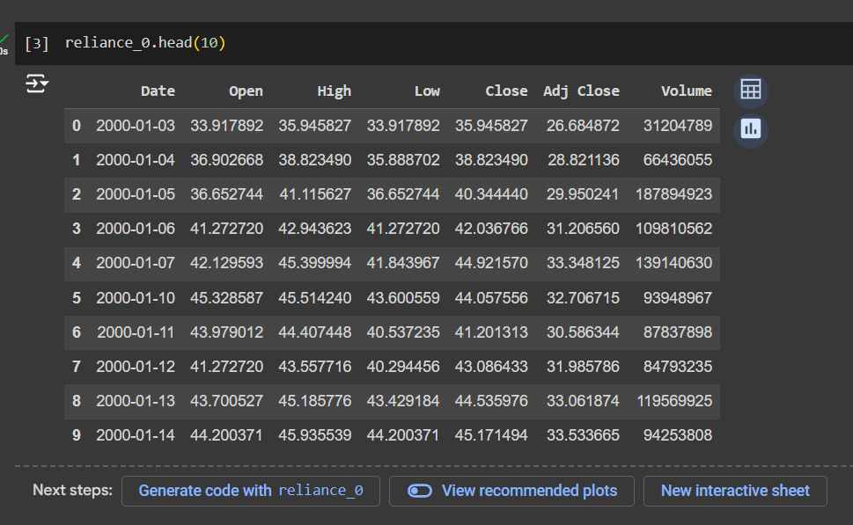
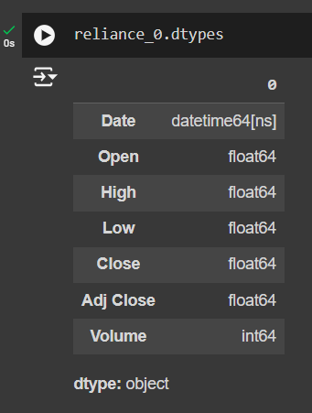
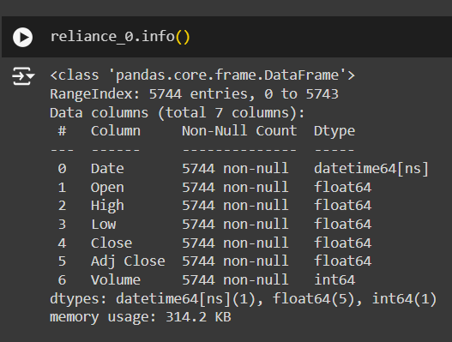
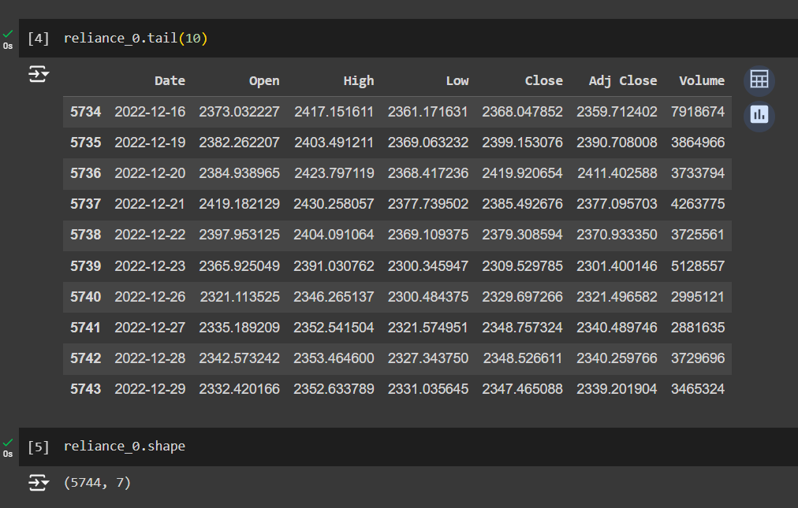
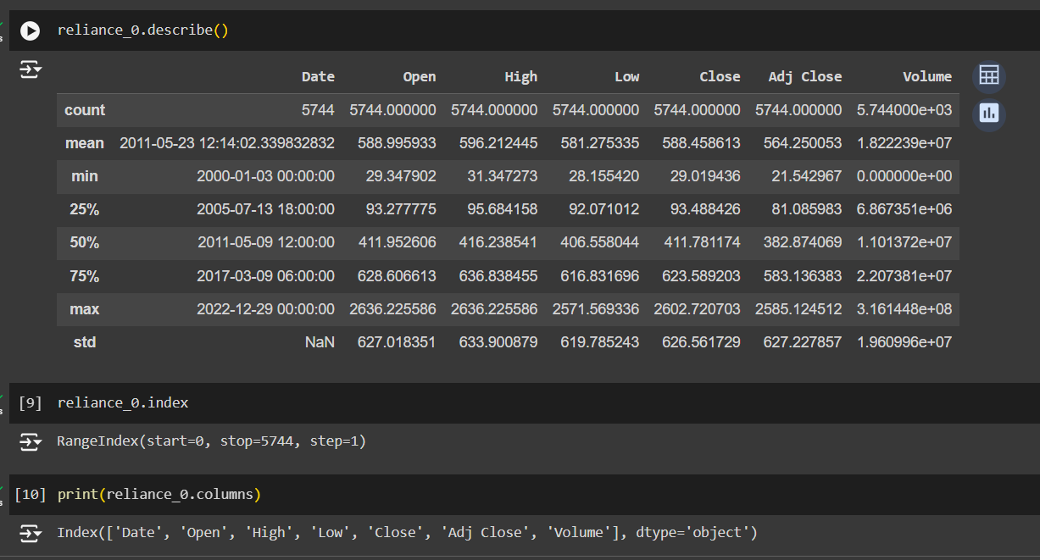

Slide 6
Data Preprocessing
Handling Missing Values:
Techniques used to clean and prepare data.
Data Transformation:
Feature scaling, encoding categorical variables.

Slide 7
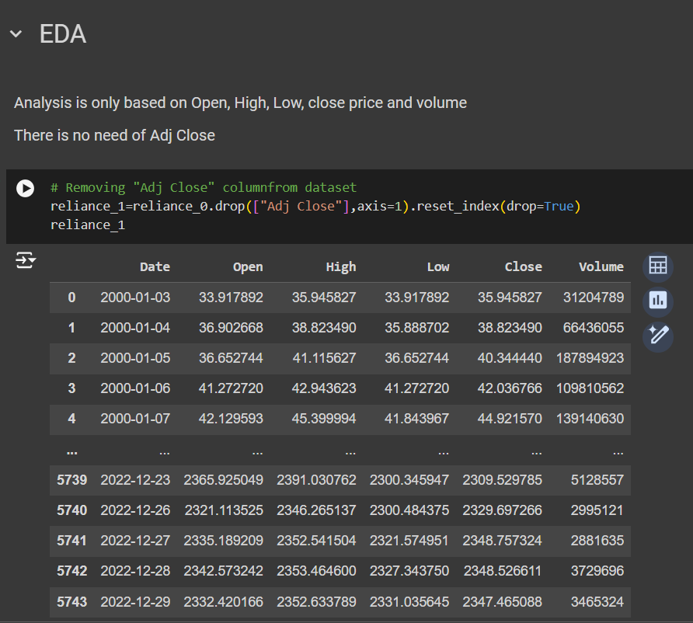
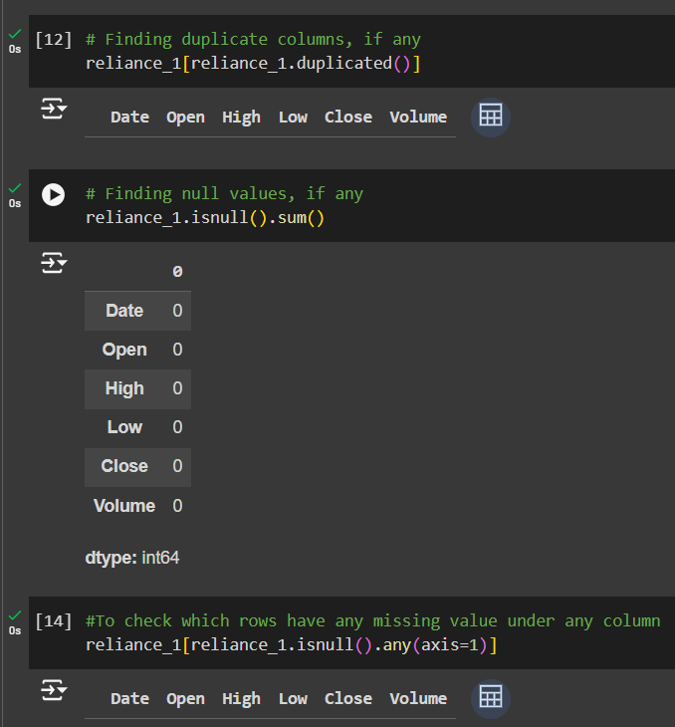
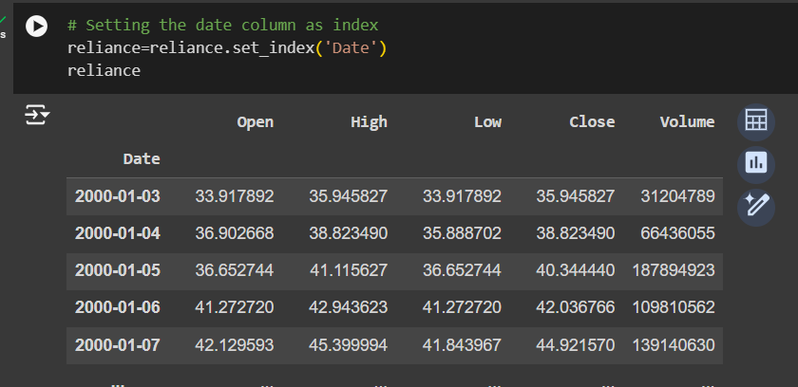
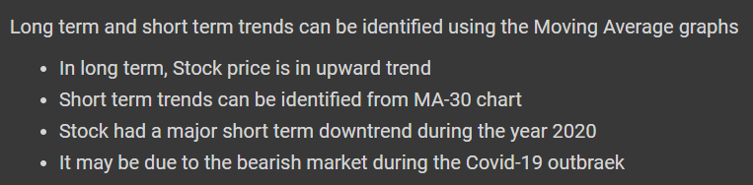

Slide 8
Exploratory Data Analysis (EDA)
Trend Analysis:
Visualizing stock prices over time.
Moving Averages:
Short-term (e.g., 10-day) vs. long-term (e.g., 50-day) moving averages.
Volume Analysis:
Analyzing the trading volume trends.

Slide 9
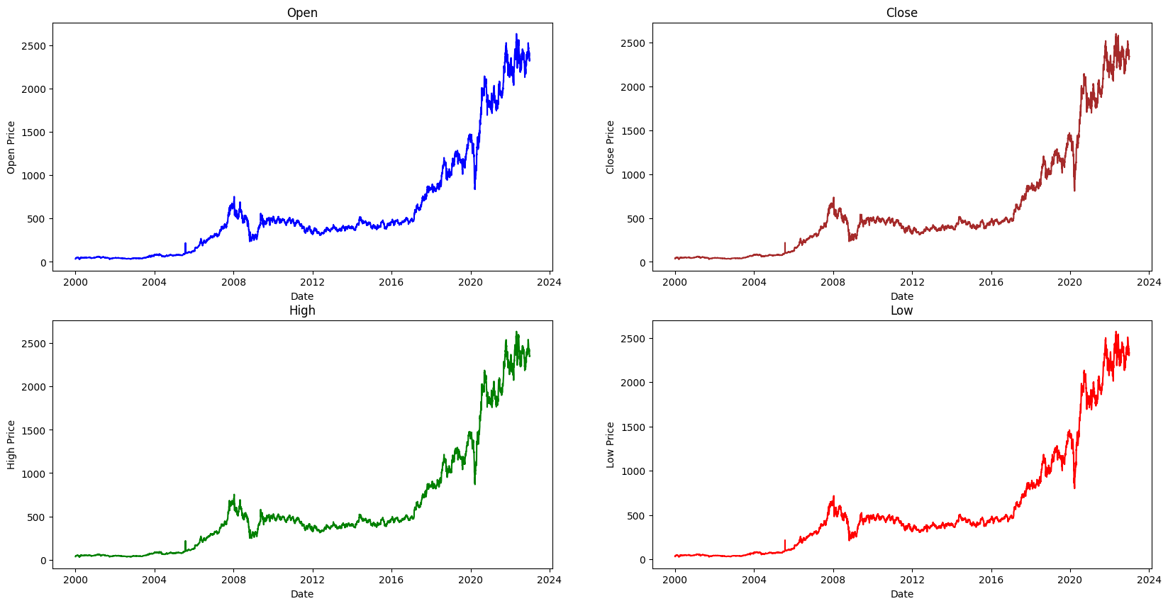

Slide 10
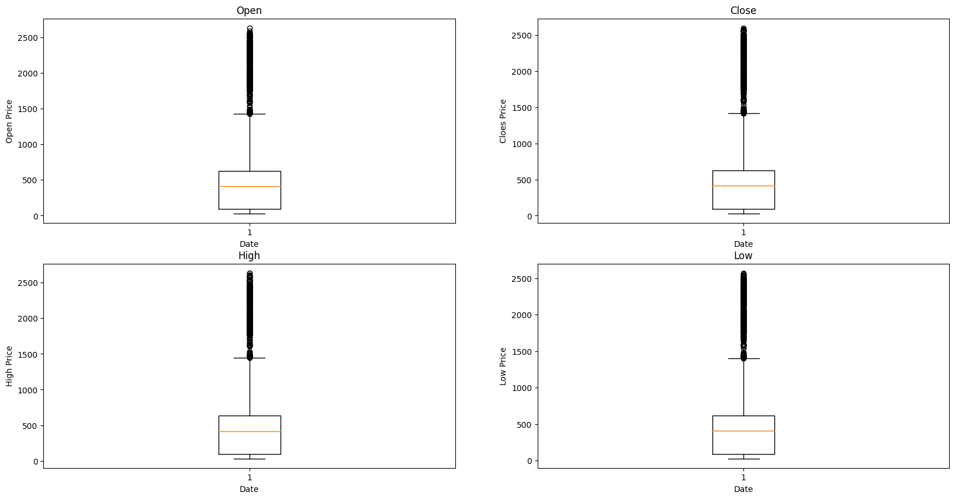

Slide 11
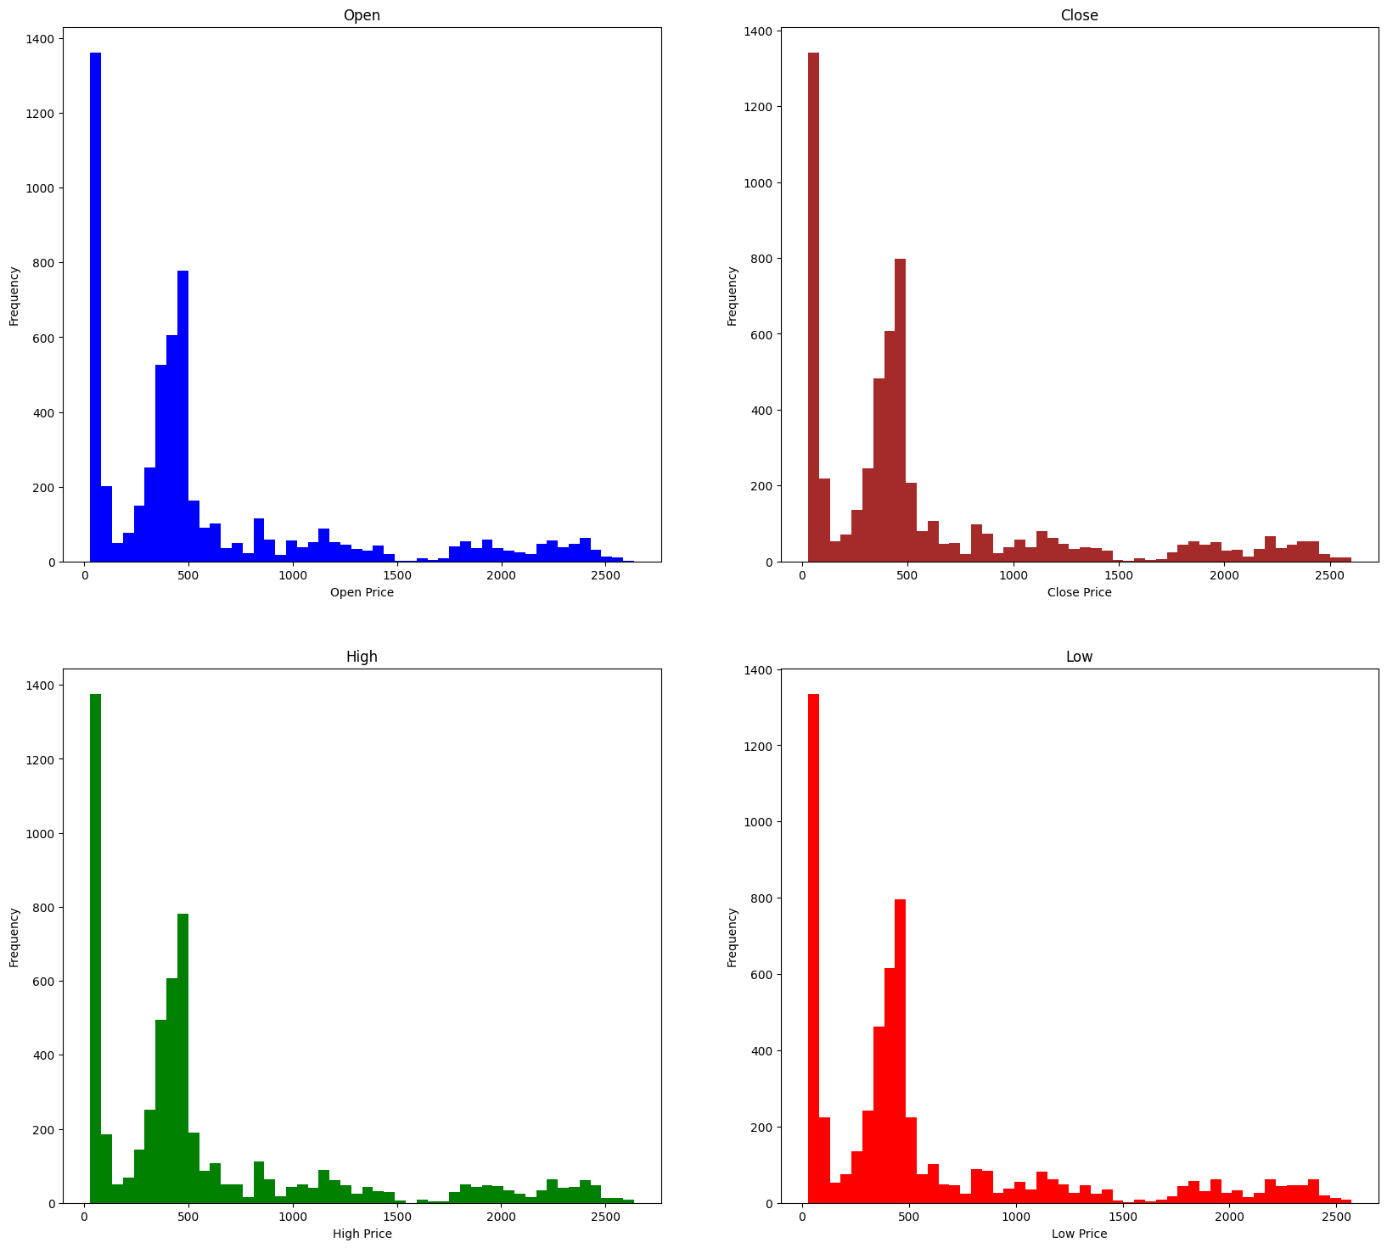

Slide 12
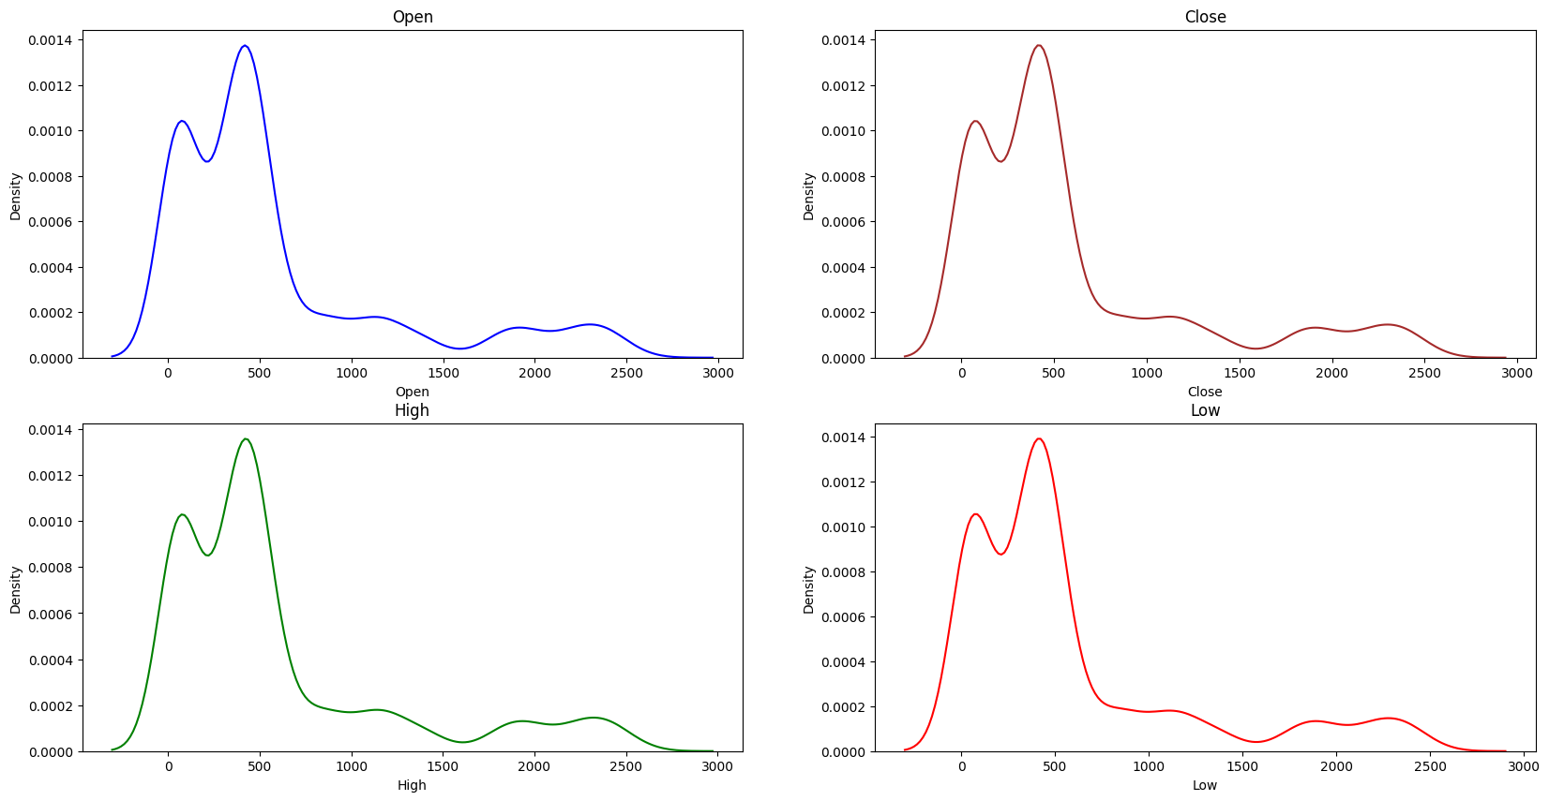

Slide 13
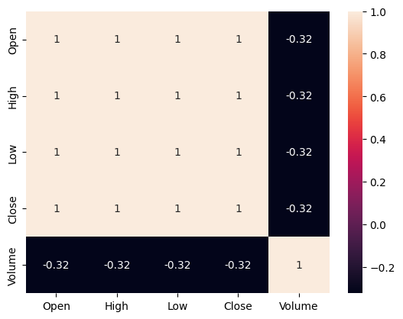

Slide 14
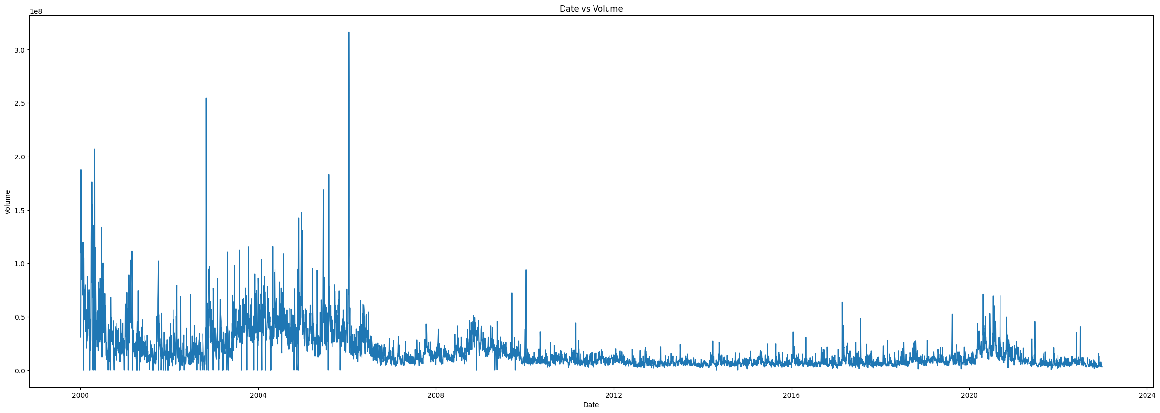

Slide 15
Feature Engineering
New Features Created:
Moving Averages (e.g., 10-day, 50-day).
Lag Features (e.g., previous day prices).
Purpose of Feature Engineering:
To enhance model predictive power.

Slide 16
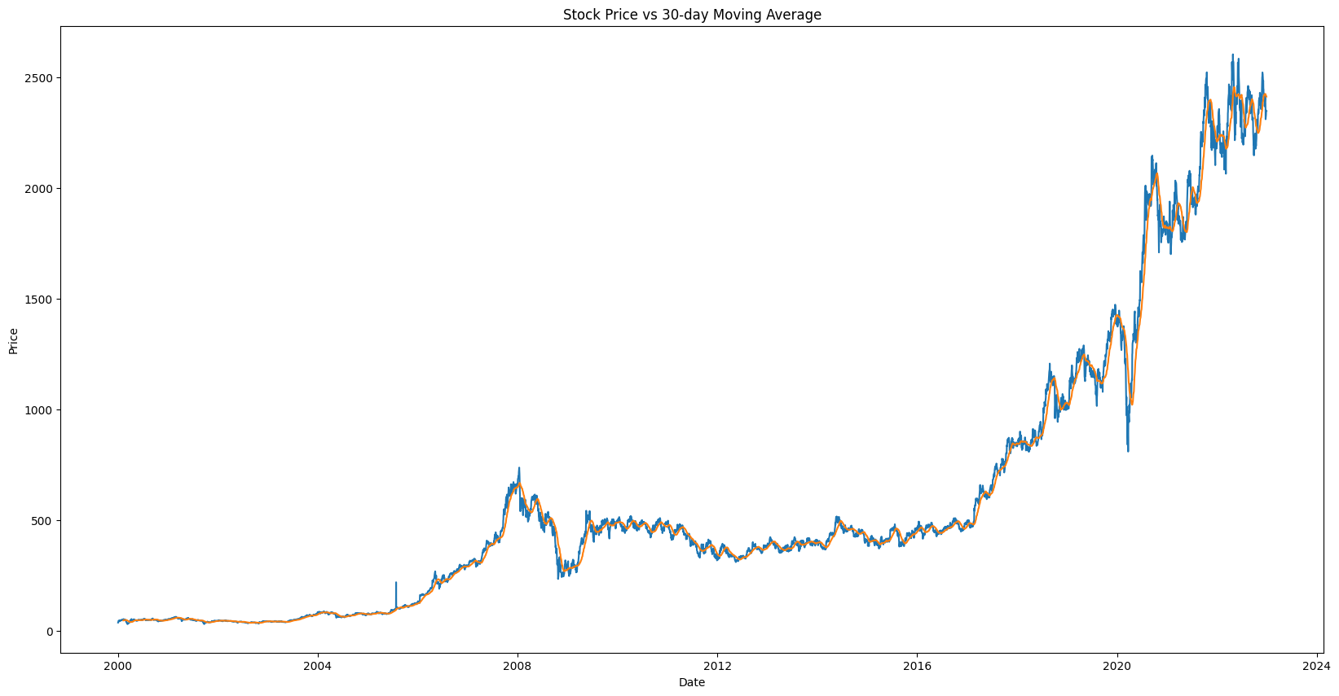

Slide 17
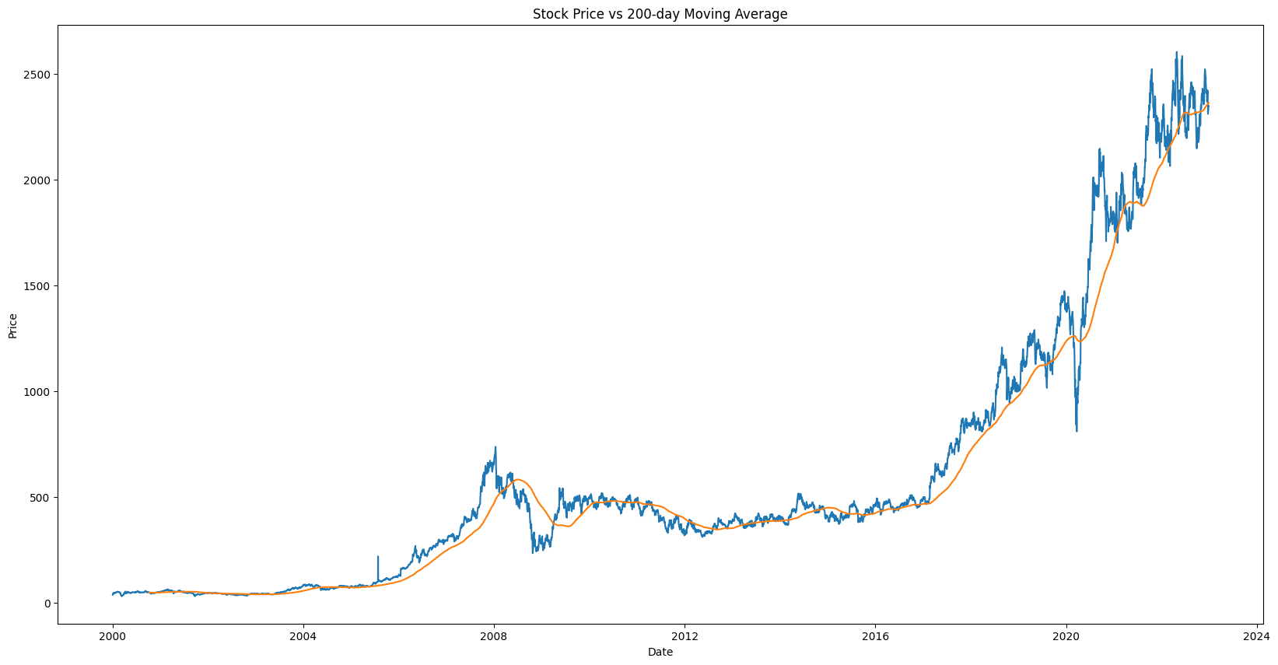

Slide 18
Model Building
Machine Learning Models Used:
ARIMA for time series forecasting.
LSTM for capturing sequential dependencies.
Comparison of model performance.
Model Evaluation:
Metrics: RMSE, MAE, Accuracy.

Slide 19
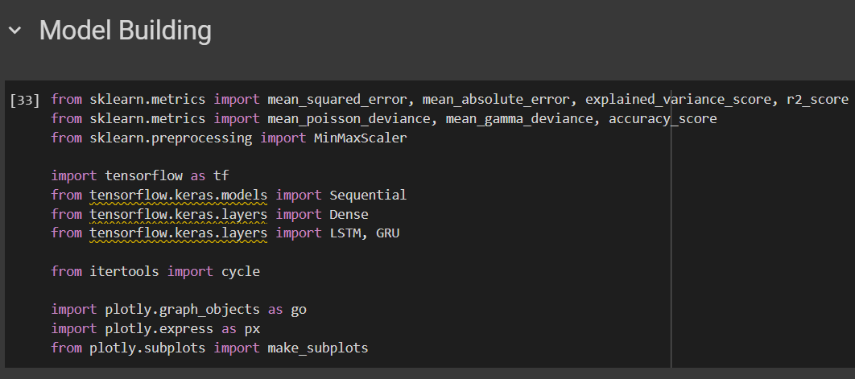

Slide 20
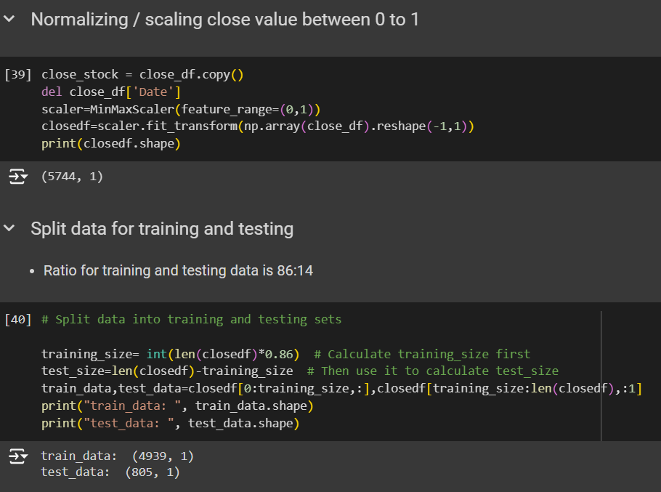

Slide 21
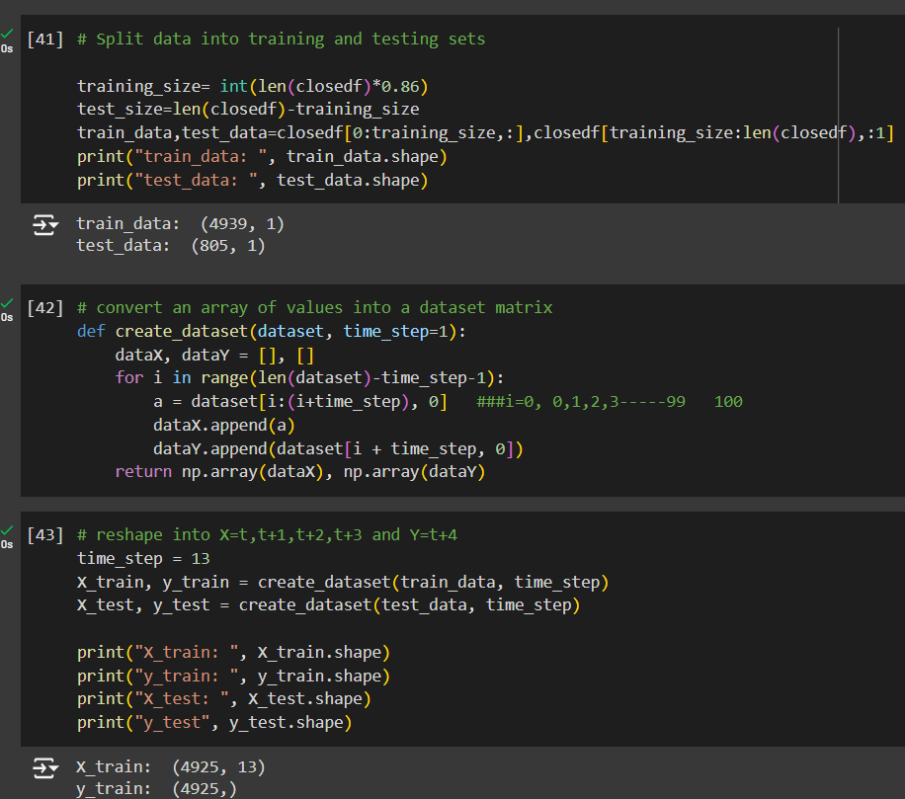

Slide 22
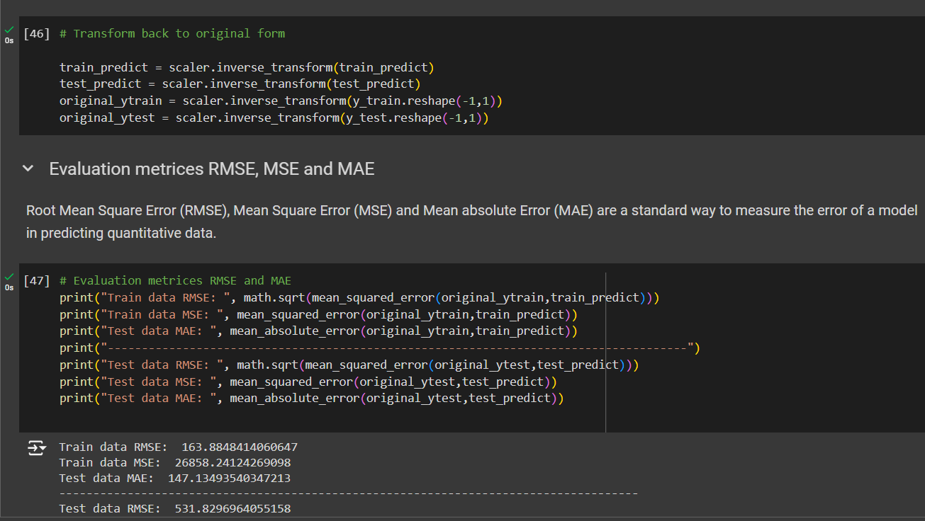
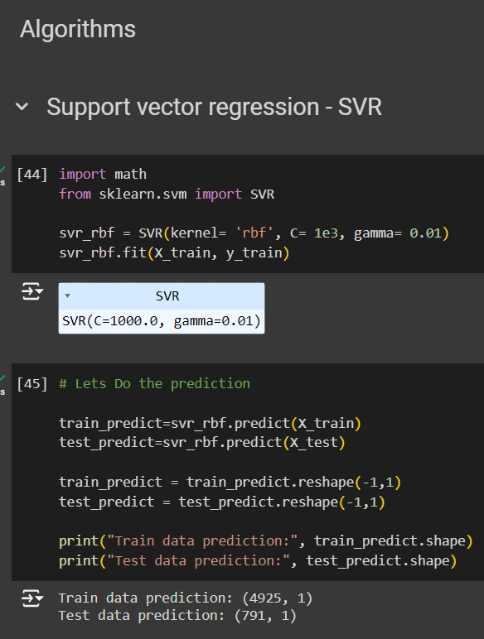
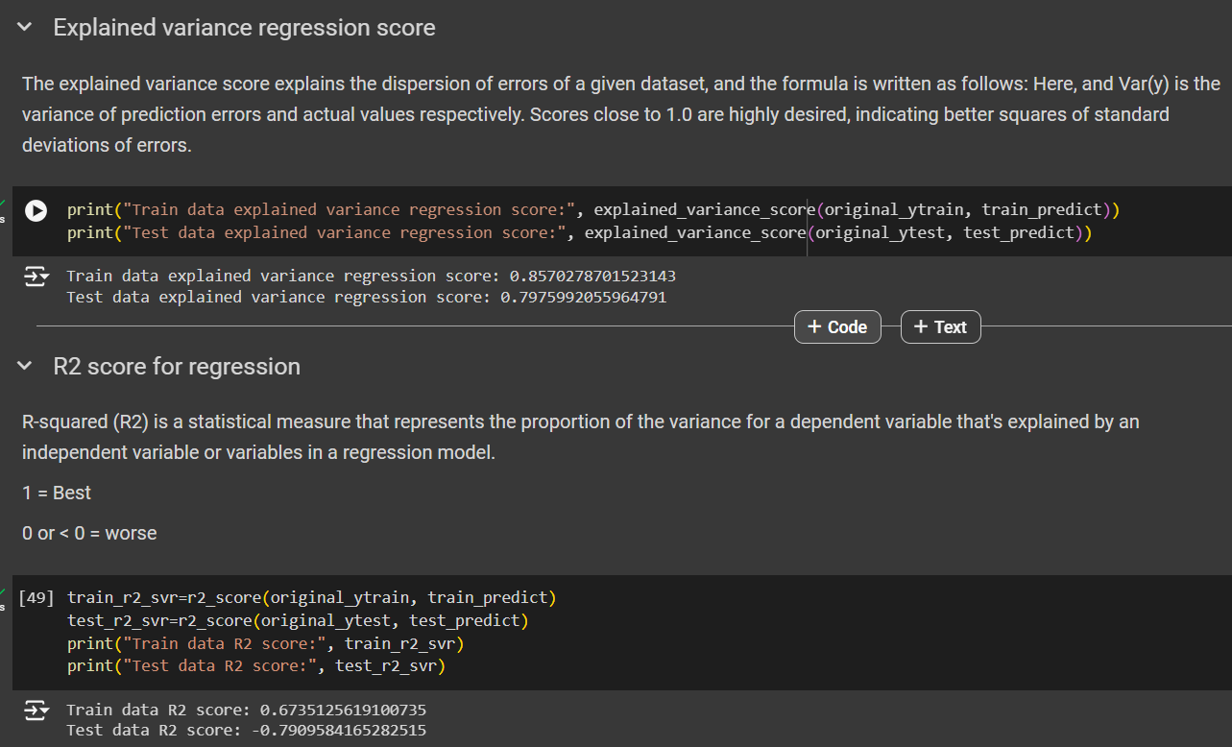
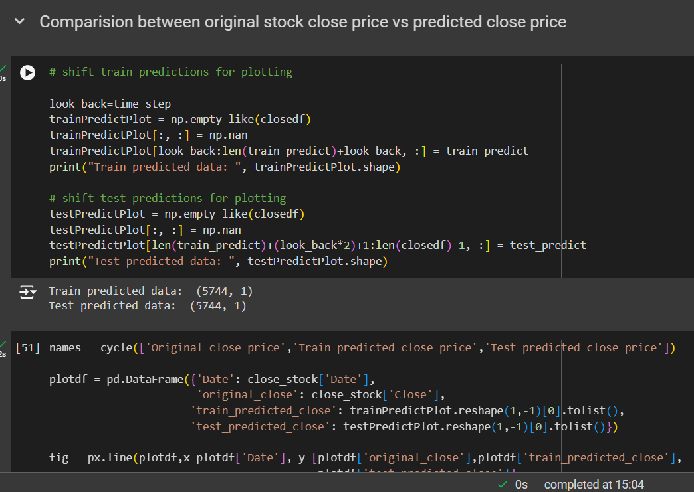

Slide 23
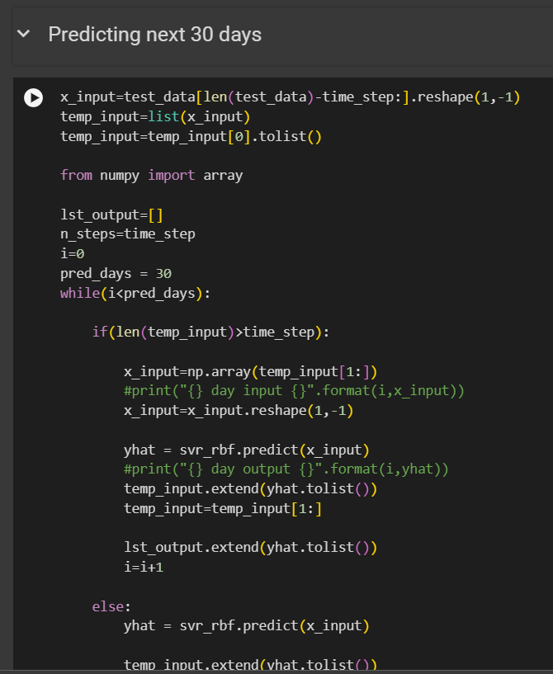
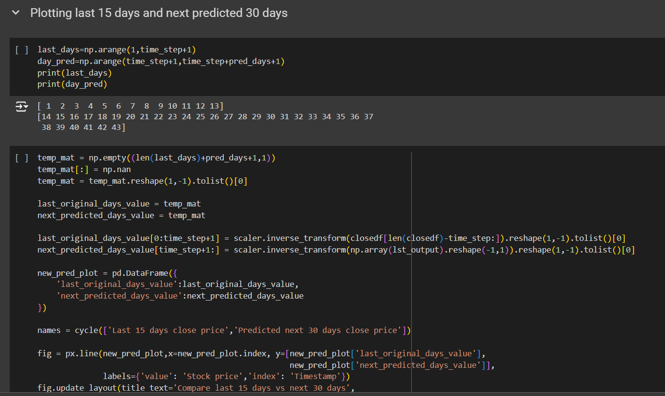
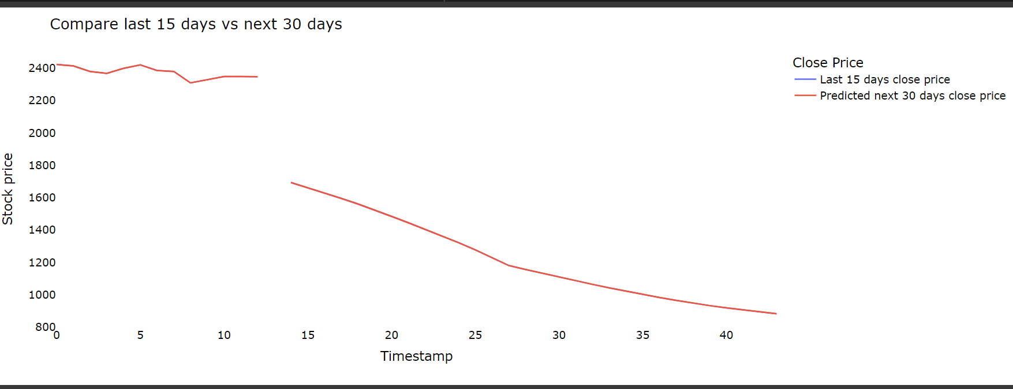
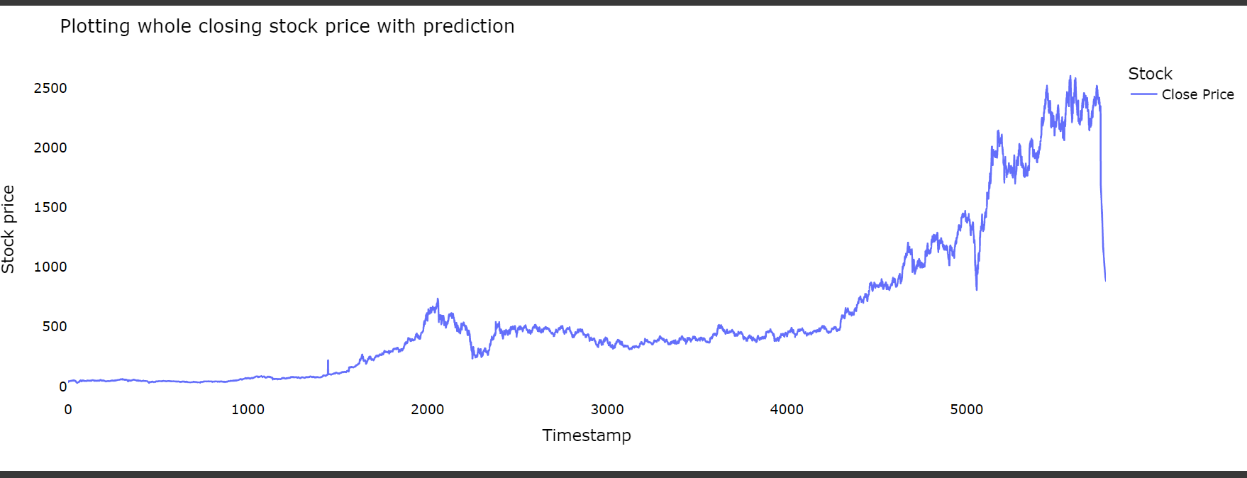

Slide 24
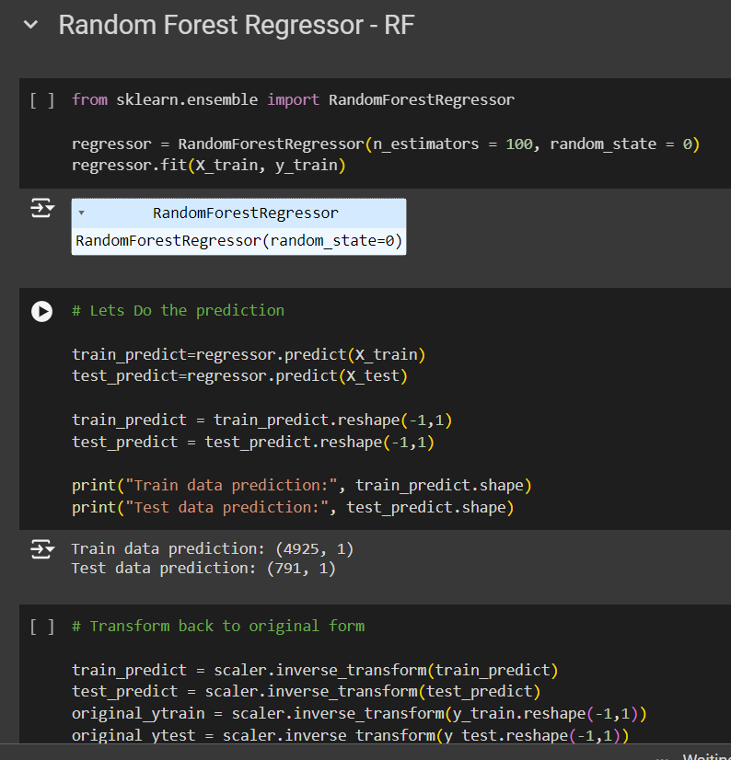
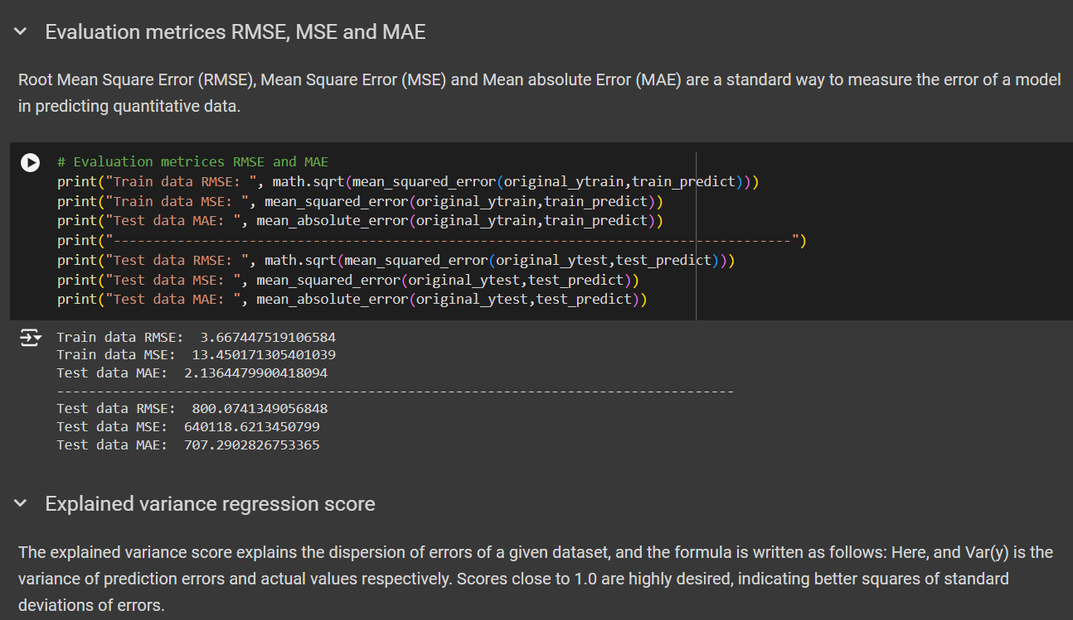
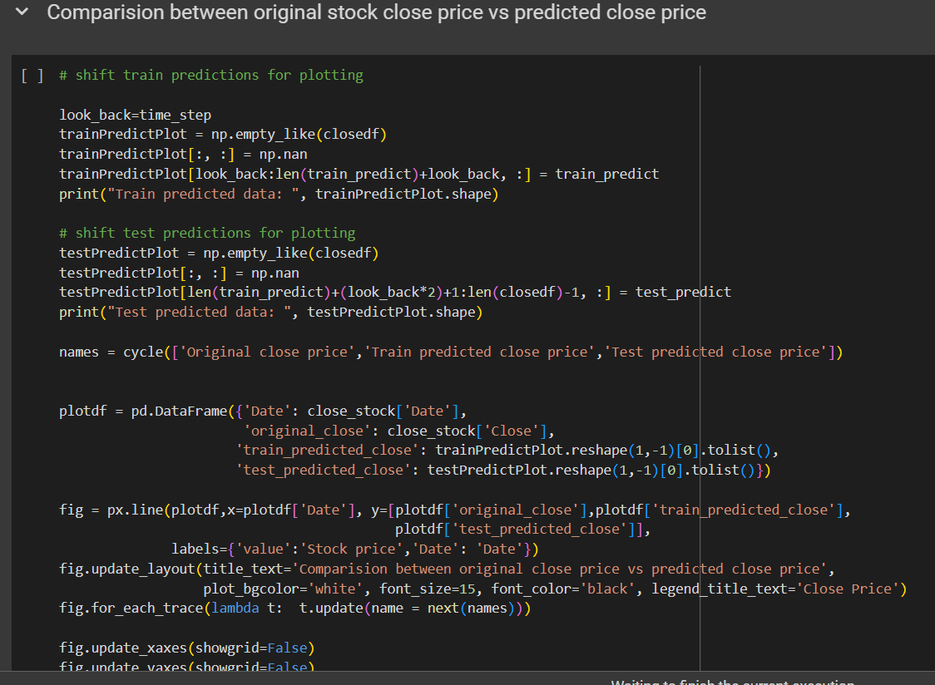
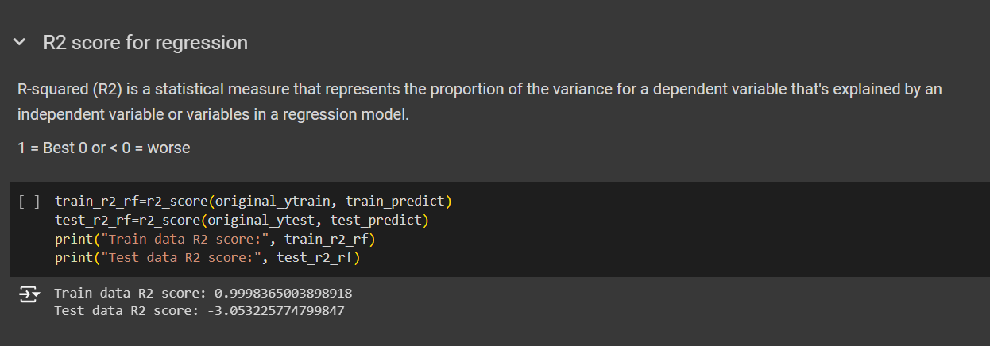

Slide 25
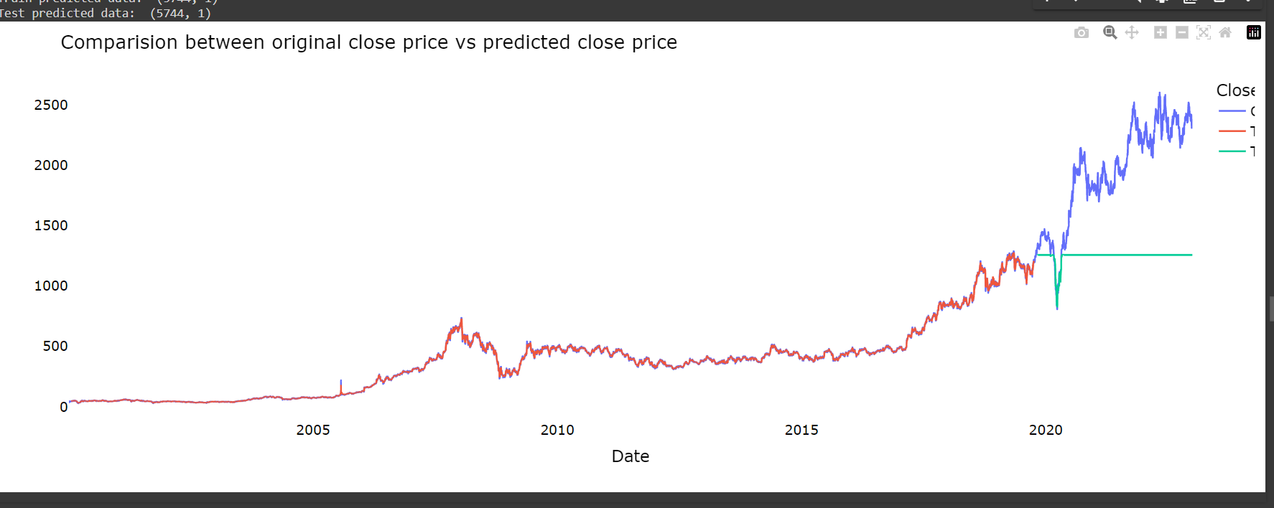
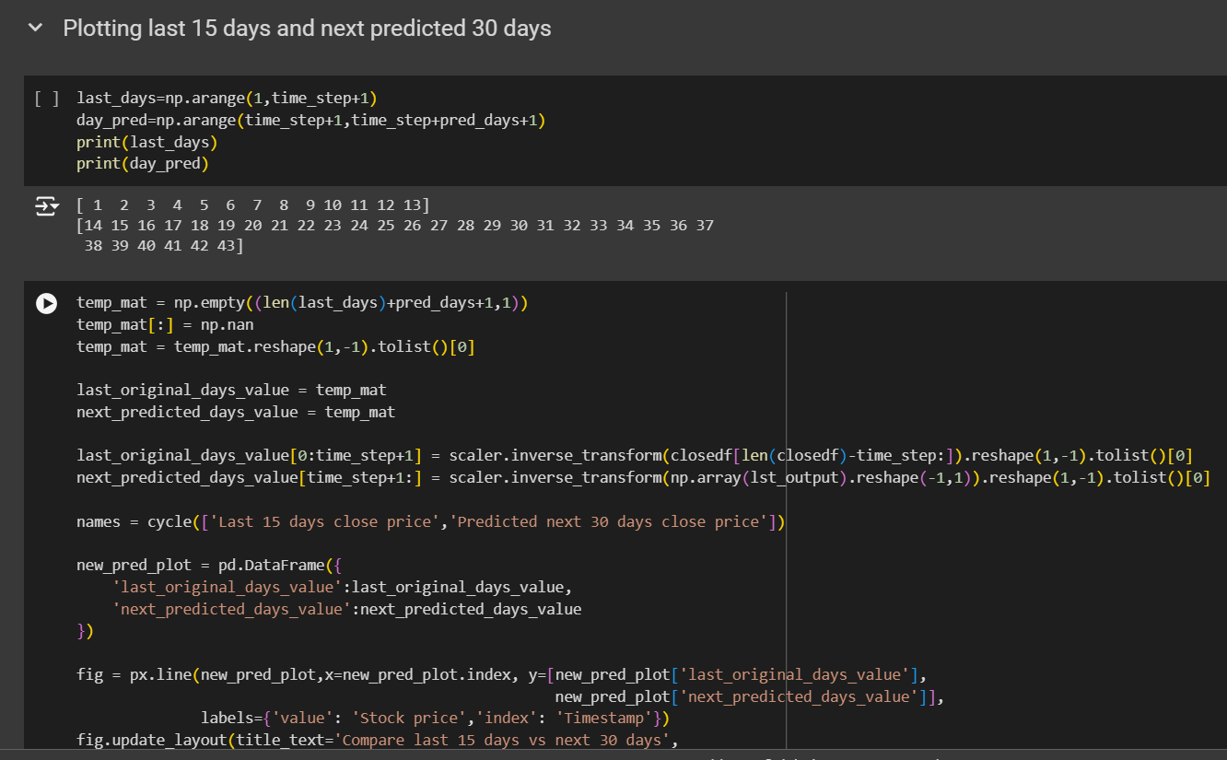
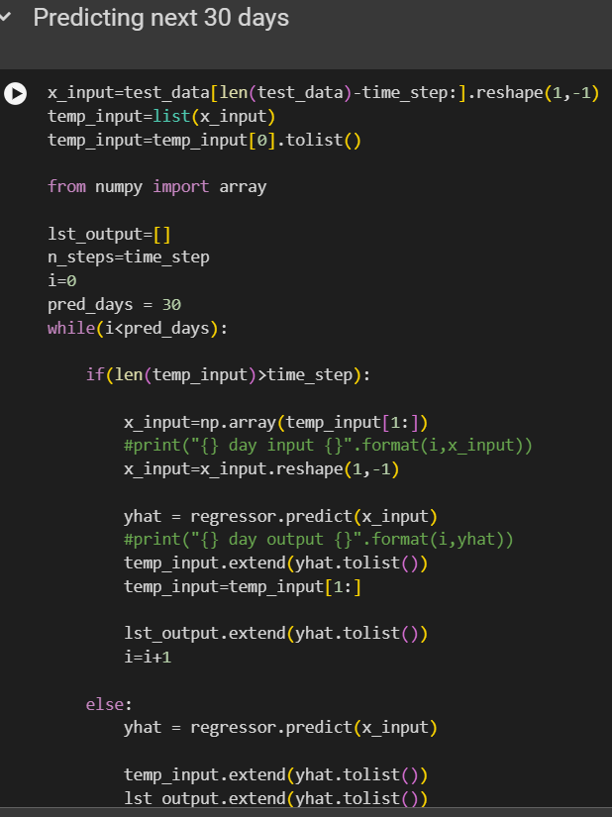
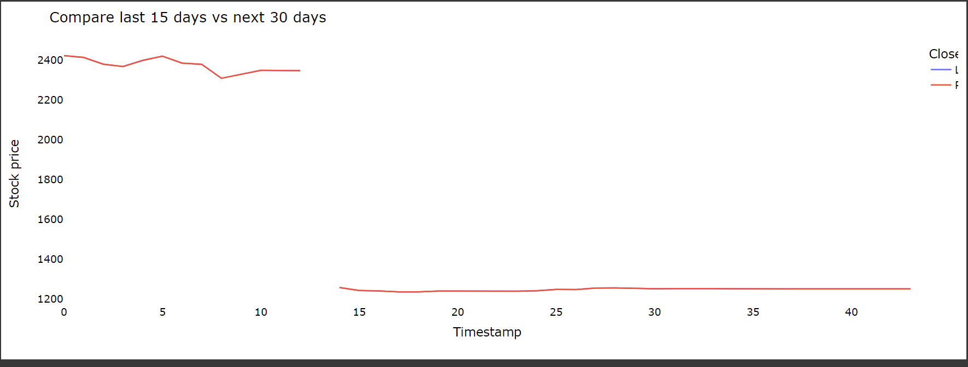

Slide 26
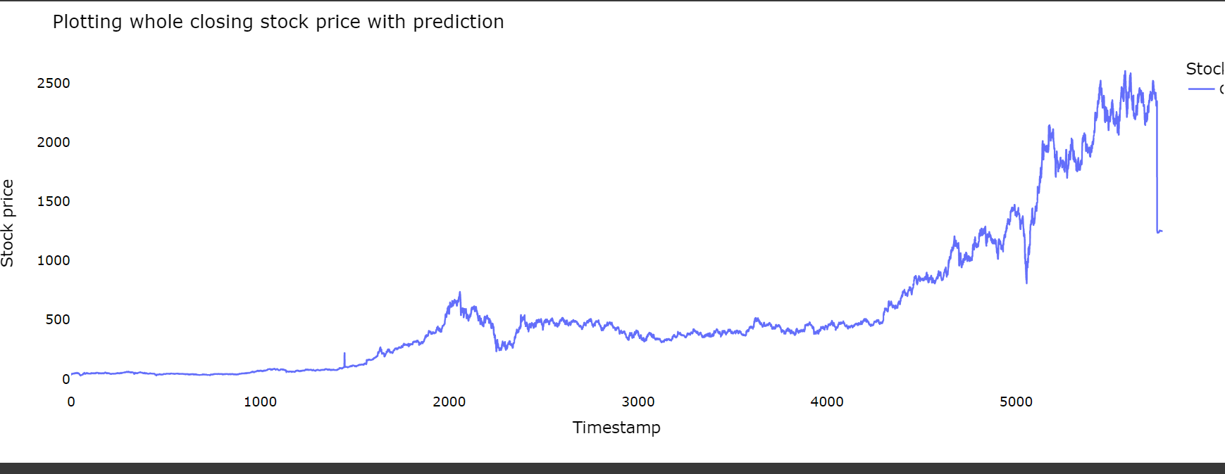

Slide 27
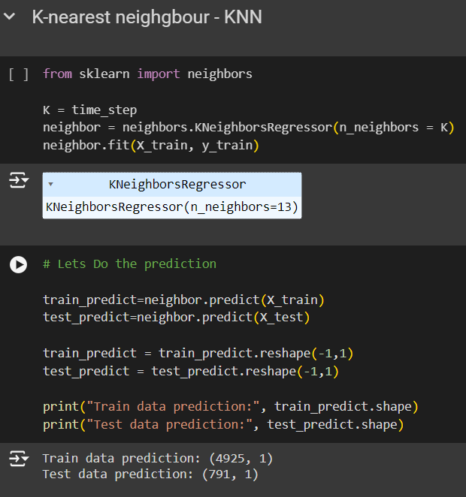
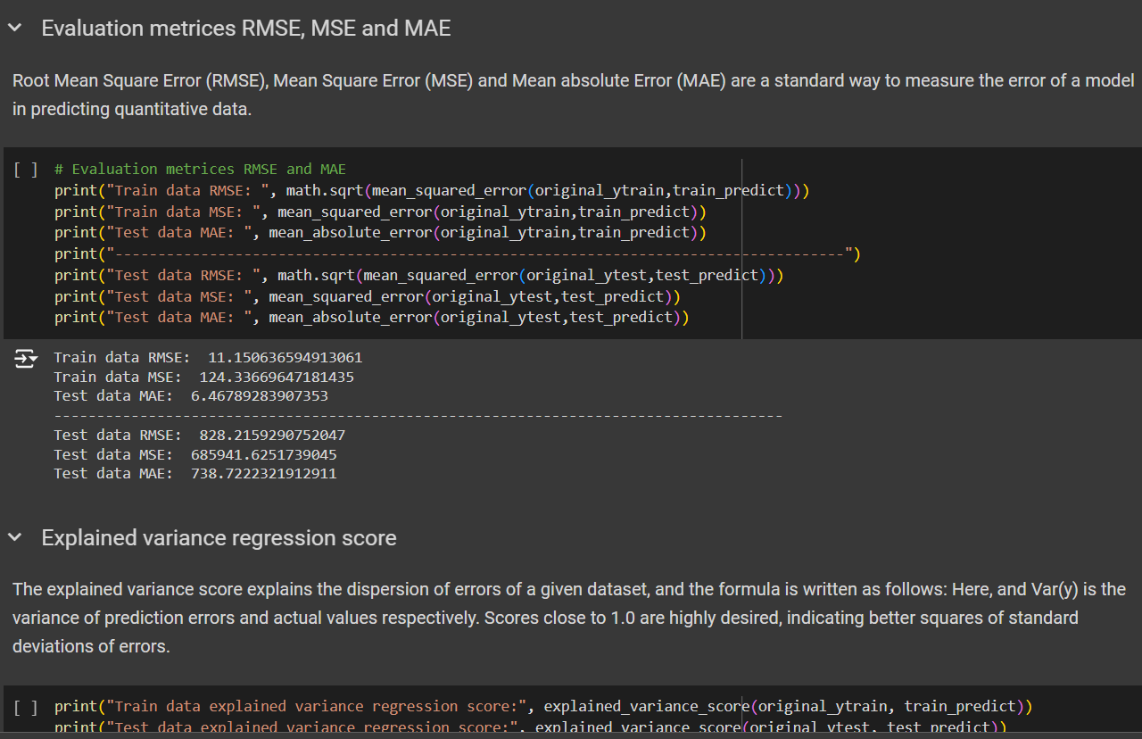
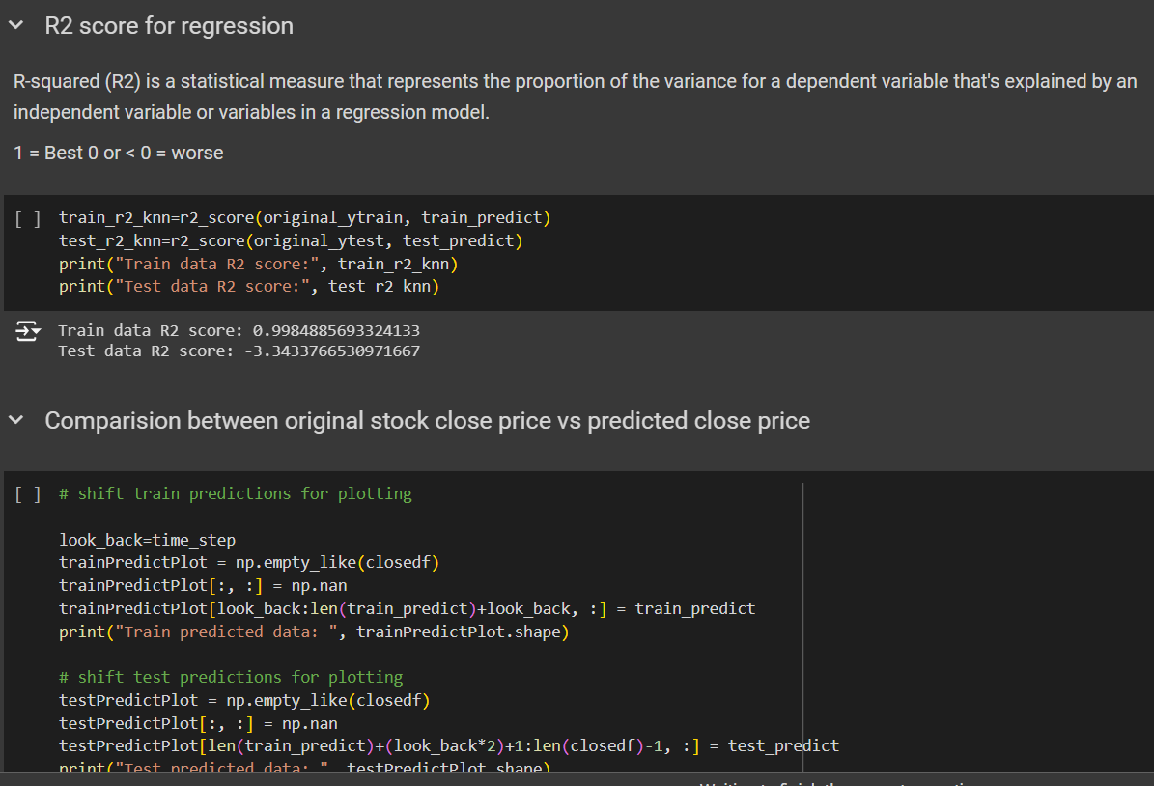
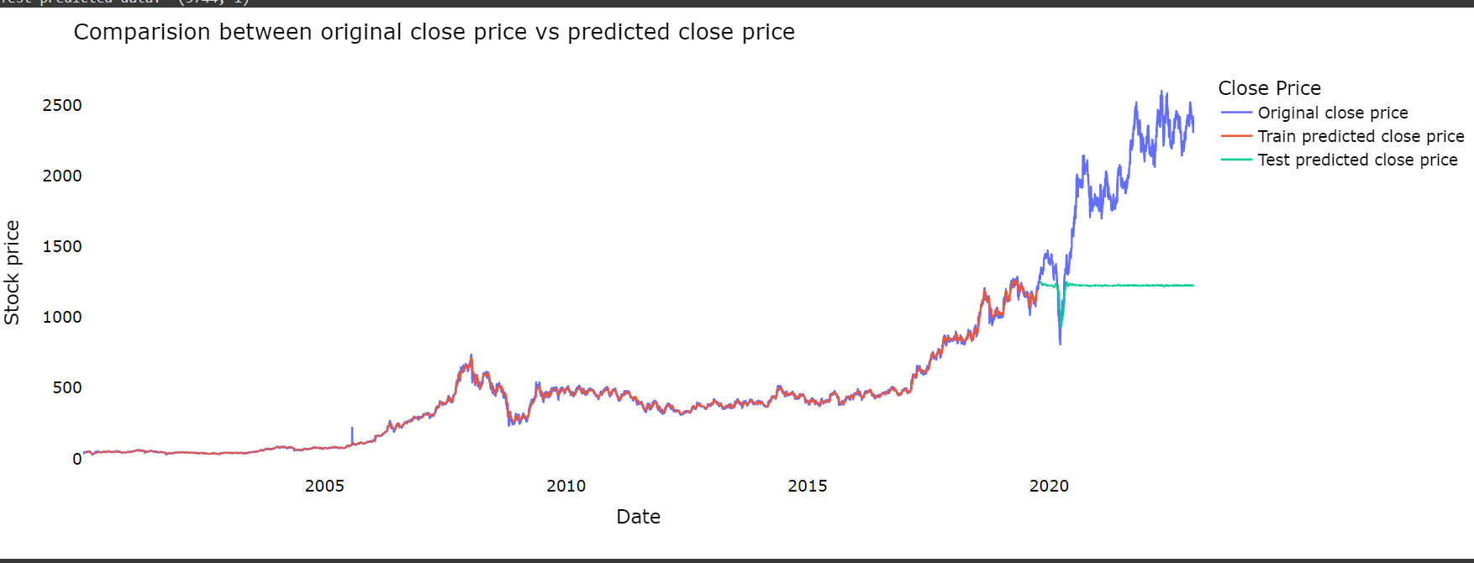

Slide 28
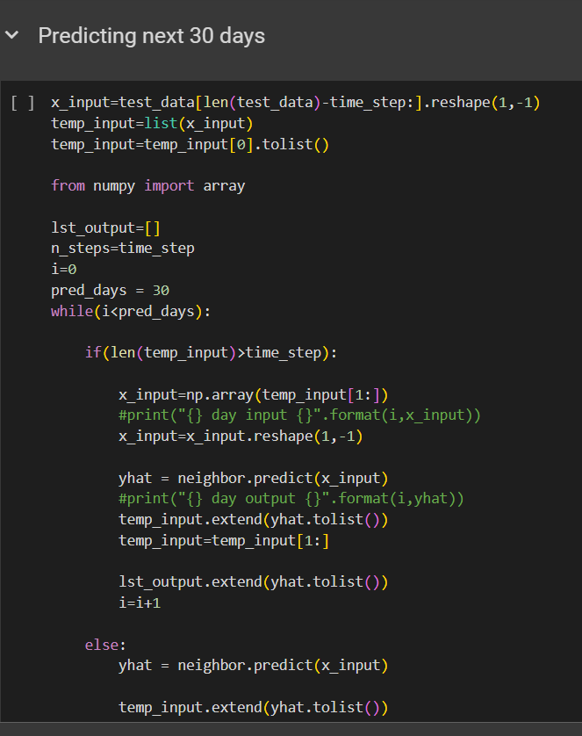
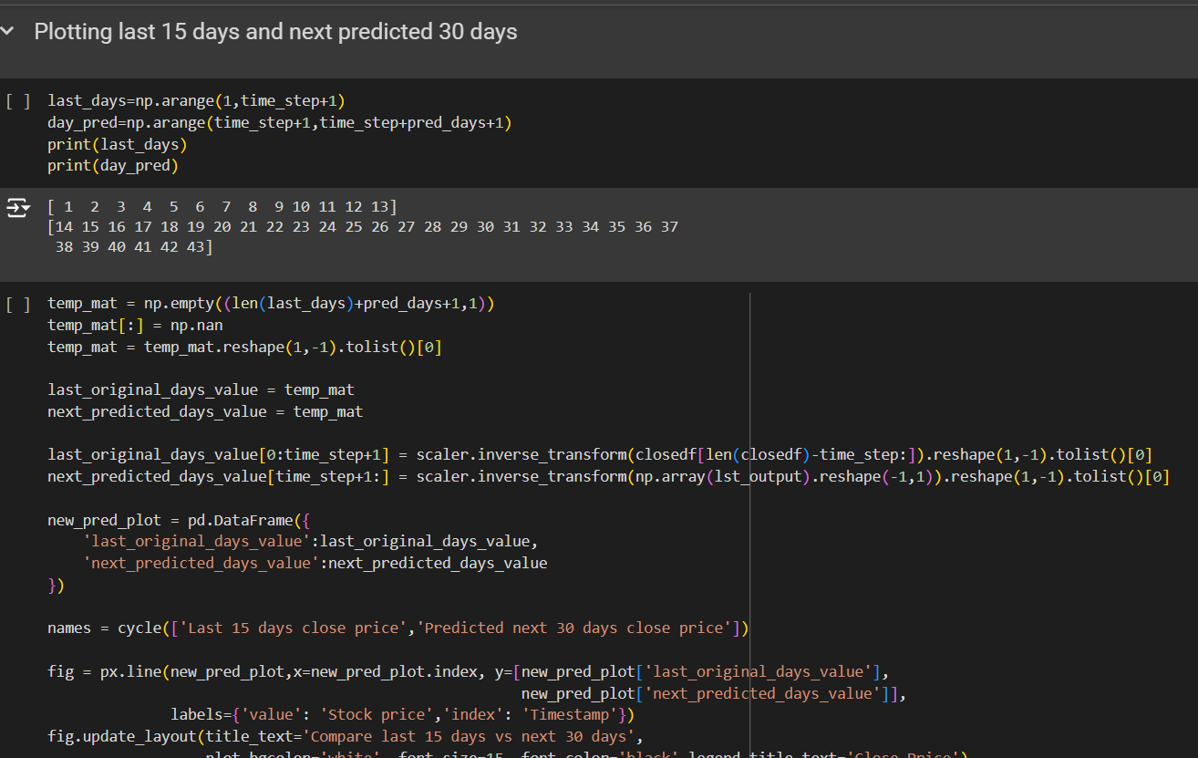
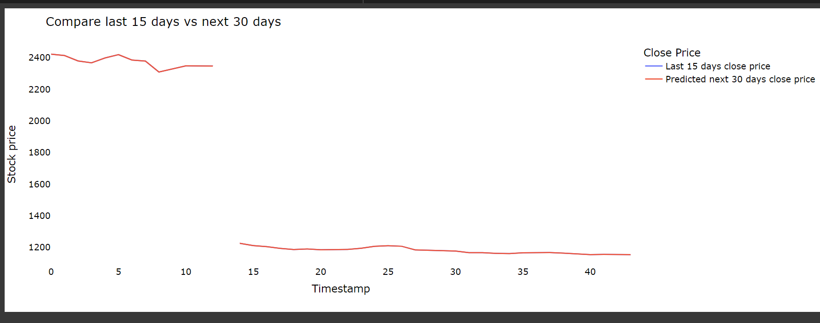
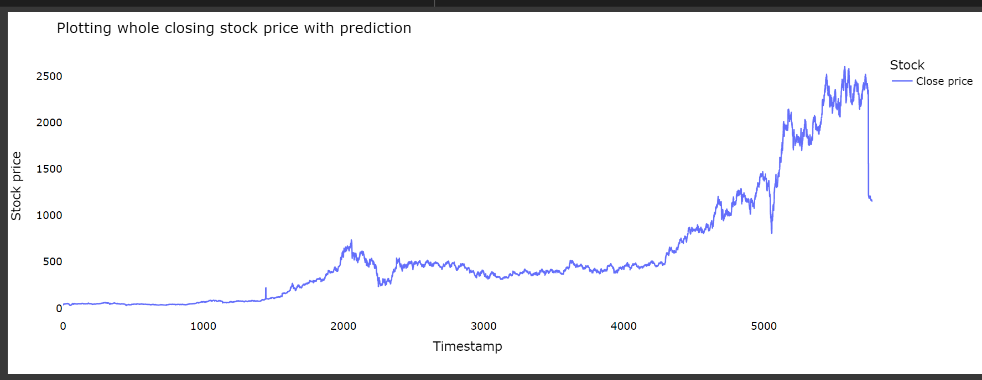

Slide 29
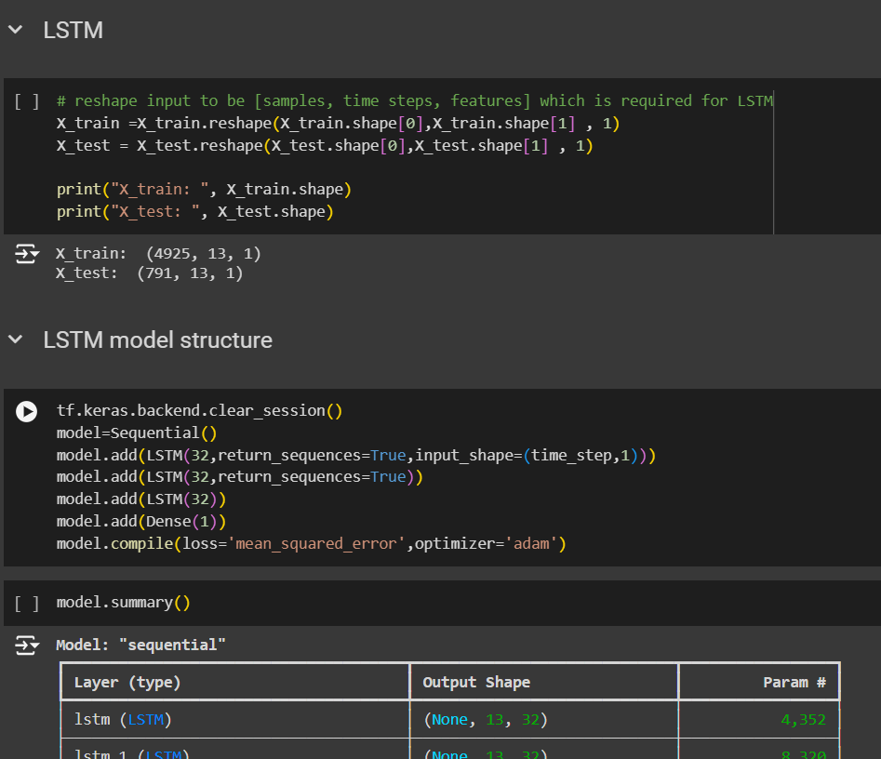
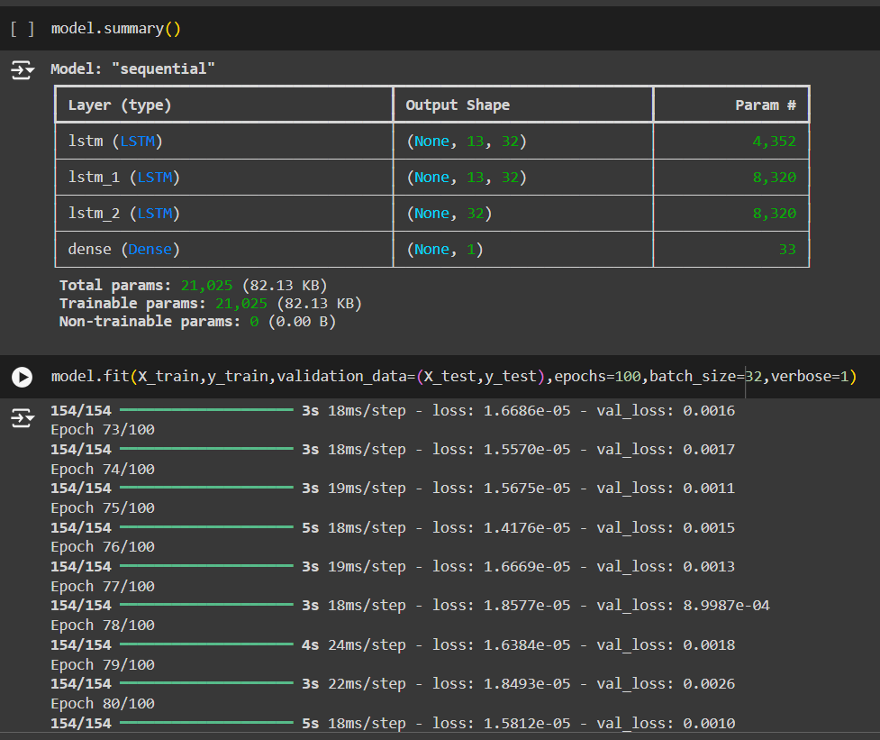
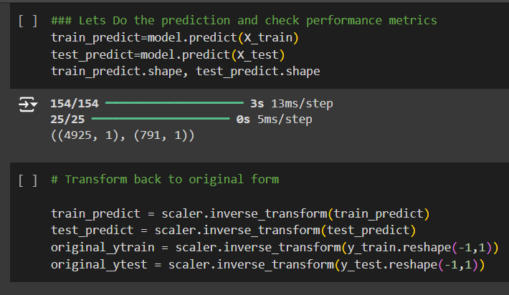


Slide 30





Slide 31




Slide 32





Slide 33





Slide 34



Slide 35




Slide 36
Model Deployment
Deployment Framework:
Using Streamlit/Flask for web app deployment.
User Interaction:
Features of the deployed app (e.g., selecting dates for prediction).

Slide 37



Slide 38



Slide 39



Slide 40
Results & Predictions
Predicted vs. Actual Prices:
Graphical representation of model predictions.
Key Findings:
Model accuracy and its ability to capture trends.

Slide 41
Thank you

